Slide 1

100 kh¨v wewkó m`i nvmcvZvj, wSbvB`n

Slide 2
Quality Improvement & Community Participation Initiative
Dr. Md. Ayub Ali
Superintendent,
Sadar Hospital,Jhenidah.

Slide 3
Introduction
Our Limitation
  Manpower
  Resource
    Money
    Materials
    Management
Difficulties
  Number of patient is increasing
So maintenance of quality is becoming difficult day by day.

Slide 4
Introduction (Cont..)
Quality Improvement Secretariate under Health Economics Unit of MOHFW
  5 S Kizen
  PDCA
Health Management Community Support Committee is a new inovation
  Idea by Dr. Emdadul Huq on 20.. From Chowgacha
  Legalized on March 2016.

Slide 5
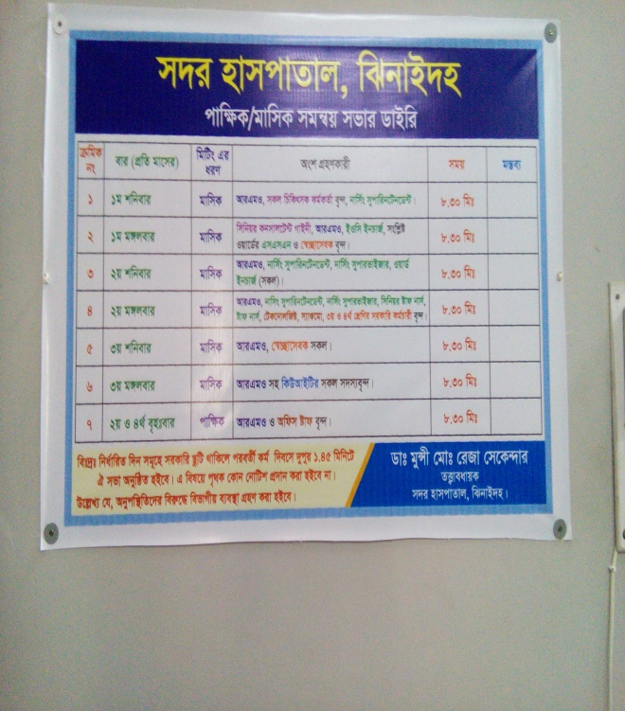
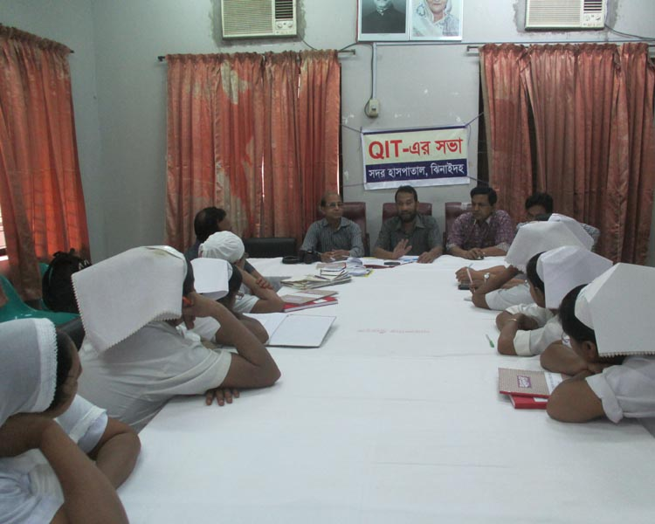
QIC in District hospital
Composition
NO of WIT - 12
Status of Monthly Meeting
Super, RMO, 1 Focal person
Team Leader of the - 12 WIT
EOC Word incharge – WIT No- 1
FSW Incharge- WIT No- 2
FMW Incharge - WIT No- 3
MSW Incharge - WIT No- 4
MMW- Incharge - WIT No- 5
OT Incharge - WIT No- 6
Emergency Incharge- WIT No- 7
Word Master Incharge - WIT No- 8
Head Assistant Incharge- WIT No- 9
Mt (lab) incharge- WIT No- 10
Storekeeper - WIT No- 11
CW – incharge - WIT No- 12

Slide 6
Status of 5S implementation
Sort(S1): Whether all WIT has addressed /completed
Set (S2): Some visible picture
Shine(S3): Some visible change

Slide 7




Changes in EOC Ward
Status of 5s implementation
Before
After
Before
After

Slide 8








Changes in Surgery Ward

Slide 9




Use of color code, alignment of picture & continuous big cleaning day
Color code
Color code
Alignment of pictures
Big cleaning day
Girls guide for lining of patients

Slide 10




Use of direction sign, labeling of rooms, clean latrine and waist segregation
Use of direction sign
Labeling of rooms
waist segregation
Clean latrine

Slide 11




Changes in Office and Hospital Internal Environment
Before
After
Before
After

Slide 12




West Management & Campus Protection
Before
After
Before
After

Slide 13





Changes in Gardens of The Hospital
Before
After
Before
After

Slide 14
Status of PDCA
Step 1:Selection of Kaizen theme with feasibility check with Matrix Diagram
Possible KAIZEN Theme | Impact to patient outcome | Affordable in terms of time and resources | Easy to measure | Under control of team members. | Total Score
Implementation of partograph | 5 | 3 | 3 | 4 | 15
Improve infection prevention | 5 | 3 | 2 | 2 | 12
Improve labor room service with added component | 5 | 5 | 5 | 4 | 19
Improve post-operative care among the operated patient | 4 | 4 | 3 | 3 | 14
Maintain proper temperature, pulse, BP in the word | 4 | 4 | 4 | 5 | 17

Slide 15
Step 2: Situation analysis
Kaizen theme: Labor room service improved with comprehensive services components.
Data collection method: Data collected by a WIT member through exit interview of 100 women
who delivered in consecutive 20 days from 4th to 24th September.
Sl No | Contributing factors | Frequency | Cumulative frequency | Cumulative %
1 | Sterile delivery set not used properly | 34 | 34 | 40%
2 | Labor room sister is not available. | 15 | 49 | 63%
3 | Chlorine solution is not used properly | 12 | 61 | 71%
4 | Counseling is not done | 10 | 71 | 84%
5 | Medical officer/Consultant is not supervise every case | 6 | 77 | 90%
6 | Labor room lighting system not functioning effectively | 5 | 82 | 96%
7 | Privacy is not maintained properly | 3 | 85 | 100%

Slide 16
Step 3: Root cause analysis (Fishbone diagram):
Sterile delivery set not used properly
Material
Man
Not purched the set
Job description is not developed
Not available in store
Division of labor not done
Demand not given
Limited manpower
Sterile delivery set not used properly
Number of delivery set is limited
Overload of the patients
Proper space is not available
Lack of importance about extra set
Unwanted articles not removed
Lack of knowledge about sterility
Authority was not informed
Lack of SOP
Initiative not taken
SOP not collected
Environment
Method

Slide 17
(b) labor room sister is not available.
Material
Man
No initiative for fund
Limited number of nurses
Fund was not available
Lack of work distribution
Not supplied from the store
Limitation of time
Labor room sister is not available.
Limited sitting arrangement
Overload of the patient
Privacy not maintained properly
Lack of proper knowledge
Lack of screening
Inadequate training
Screen not supplied
Lack of on-the-job training
Demand not given for screening
Lack of initiative of on-the-job training
Environment
Method

Slide 18
(c) Chlorine solution is not used properly
Material
Man
Chlorine is not purched
Lack of initiative for manpower
Chlorine supplies is limited
Shortage of manpower
Indent is not given in proper time
Work distribution is not done
Chlorine solution is not used properly.
Irregular supplies of chlorine
Overload of the patient
Delay for preparation
Lack of importance about chlorine solution
Preparation not started in time
Lack of knowledge
Supervision not done properly
Training not done properly
Initiative not taken for supervision
Initiative not taken
Environment
Method

Slide 19
(d) Counseling not done among the team members
Material
Man
Not prepared the poster & chart
Lack of initiative for manpower
Not available in store
Shortage of manpower
Not collected from store
Work distribution is not done
Poster and chart was not available
Overload of the patient
Counseling not done
Over load of the patient
Lack of importance about counseling
Limited time
Lack of SOP
Distribution of time
SOP not collected
Orientation about work in time
SOP not supplied
Environment
Method

Slide 20
Step 4: Identification of actions/countermeasures
Root cause | Primary action | Secondary action | Importance | Urgency | Difficulty | Time consumption | Resource availability | Total score
No initiative for extra manpower | Initiative for extra manpower | Identify the extra manpower | 4 | 3 | 2 | 2 | 1 | 12
 |  | Rearrangement of manpower | 2 | 2 | 1 | 2 | 2 | 9
Delivery set was not available | Arrangement of good quality of delivery set | Purchase of delivery set | 3 | 3 | 2 | 2 | 2 | 12
 |  | Identify good quality of delivery set | 3 | 3 | 2 | 2 | 2 | 12
No SOP for using sterility of delivery set | Arrangements of SOP for using sterile sets | Collection of SOP for sterility module | 3 | 3 | 2 | 3 | 3 | 14
 |  | pre and post training arrangement | 3 | 3 | 3 | 2 | 2 | 13
Less number of nurses | Arrangement of extra nurses | Posting of new nurses | 3 | 3 | 2 | 2 | 2 | 12
 |  | rearrangement of nurses | 3 | 3 | 3 | 2 | 3 | 14
No initiative of fund for sitting arrangement | Initiative for fund for sitting arrangement | Identify the probable cost of the chairs | 3 | 2 | 2 | 2 | 2 | 11
 |  | Identify the donors for the support | 3 | 3 | 3 | 2 | 1 | 12
Not taken initiative for good quality chlorine solution | Indenting of good quality chlorine solution | Purchase of chlorine solution | 3 | 3 | 2 | 2 | 2 | 12
 |  | Orientation about the use of the solution | 3 | 2 | 1 | 2 | 2 | 10
 |  | Identify the person supervises regularly | 3 | 2 | 2 | 2 | 2 | 11
Initiative not taken for supervision of sterility | Organize regular supervision system | Make a checklist for quality investigation | 3 | 3 | 3 | 2 | 2 | 13
 |  | Ensure regular on-the-job training | 3 | 3 | 3 | 2 | 2 | 13
Initiative not taken for counseling | Arrange effective counseling system | Identify the points for counseling | 3 | 3 | 3 | 2 | 2 | 13
 |  | Regular monitoring the system of counseling | 3 | 3 | 2 | 2 | 2 | 12

Slide 21
Step 5: Implementation of actions/countermeasures: action plan and progress monitoring for EOC ward (WIT-1)
Sl | Actions | Where | Who | When | Date of monitoring | Who | Progress
1 | Identify the extra manpower | EOC ward | Consultant | 20 to 30 Oct | 28 Oct | RMO
2 | Purchase of delivery set | EOC ward | Hospital Super | 30 Oct to 15 Nov | 10 Nov | Super
3 | Collection of SOP | EOC ward | Consultant | 15 to 20 Nov | 18 Nov | Focal Person
4 | Posting of extra nurses | EOC ward | Hospital super | 20 to 30 Oct | 25 Oct | Focal Person
5 | Initiative for fund | EOC ward | Consultant | 25 Oct to 5 Nov | 30 Oct | RMO
6 | pre and post training arrangement | EOC ward | Store keeper | 25 Oct to 15 Nov | 30 Oct | RMO
7 | Identify the points for counseling | EOC ward | Hospital super | 15 Oct to 20 Nov | 17 Nov | Focal Person
8 | Regular monitoring the system of counseling | EOC ward | Team Leader | 15 Nov to 20 Nov | 17 Nov | Focal Person
9 | Purchase of chlorine solution | EOC ward | Hospital super | 25 Oct to 10 Nov | 5 Nov | Super
10 | Initiative taken for supervision | EOC ward | Hospital Super | 30 Oct to 15 Nov | 10 Nov | Super

Slide 22
Step 6: Effectiveness of actions/countermeasures
Sl No | Contributing factors | Frequency |  | Frequency Reduction | Reduced%
 |  | Before PDCA | After PDCA
1 | Sterile delivery set not used properly | 34 | 10 | 24 | 71%
2 | Labor room sister is not available. | 15 | 3 | 12 | 80%
3 | Chlorine solution is not used properly | 12 | 2 | 10 | 83%
4 | Counseling is not done | 10 | 3 | 7 | 70%
5 | Medical officer/Consultant is not supervise every case | 6 | 1 | 5 | 83%
6 | Labor room lighting system not functioning effectively | 5 | 1 | 4 | 80%
7 | Privacy is not maintained properly | 3 | 0 | 3 | 100%

Slide 23
Status of Communication Plan ( what has developed in last workshop in BRAC CDM)
Health education
Hospital Authority & Public face to face meeting – TIB
Inter personal Communication.
Group communication.
Health Fair
Facebook
Display of citizen charter.

Slide 24
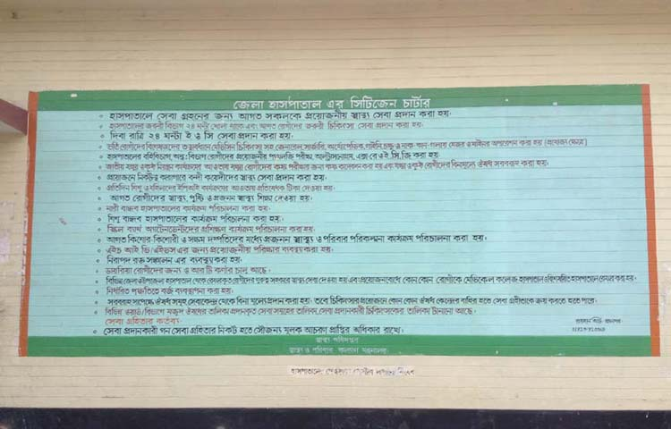

Slide 25
Community Support Committee
Composition
Meeting
Mayor, Pouroshova, Jhenidah
Rep. of Hon. MP,
Rep- DC,
Rep- SP
Rep- CS
Rep- BMA
RMO
Rep- BAR
Rep- Pressclub
Dist. Social Fair Officer,Rep- NGO
Rep- Alit Society ,
Superintendent DH – Mem Secretary
Advisor- Civil Surgeon
2-5-16 - 7-1-18. Total- 9
Meeeting Date-
2/5/16 – 1st mett.
28/6/16 - 2nd
25/7/16 - 3rd
27/10/16 - 4th
5/2/17 - 5th
8/4/17 - 6th
22/6/17 - 7th
10/10/17 - 8th
7/1/18 – 9th

Slide 26
Major decision of Community participation committee meeting
Active Community Participation
2. Reception room with manpower (by local initiatives)
3. Health education in three places
4. Established NCD corner mainly for senior citizen
5. Bi-cycle stand
6. Neonatal Care Unit
7. Separate pediatric word
8. Separate pediatric outdoor
9. Gate pass system
Mobile court
Digital X-ray machine
Representative control
Beautification
Solar Light , Generator
Wheel chair

Slide 27
Status of implementation of community participation
Maximum major decision are implemented .

Slide 28
Innovative approach
What approaches have been taken or being planned ??

Slide 29




Innovative activities of Jhenaidah Sadar Hospital Page: 1
Reception room
Creation of nursing aid
Health education session
Community engagement

Slide 30





Innovative activities of Jhenaidah Sadar Hospital Page: 2
Starting of 5S KAIZEN-TQM
Neonatal Care Unit
Manobota
Big Cleaning Day

Slide 31



Innovative activities of Jhenaidah Sadar Hospital Page: 3
Community donated intercom
Community Supported Manpower

Slide 32



Improved pediatric word by local initiative

Slide 33
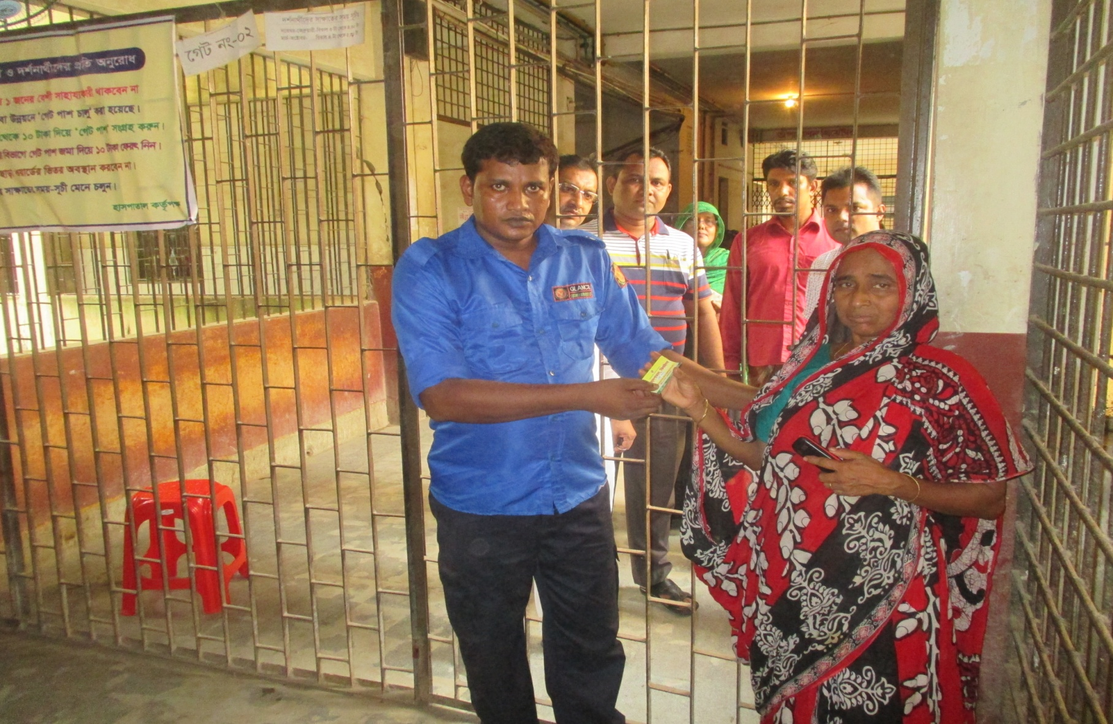
Gate pass System

Slide 34




Hospital Environment

Slide 35
Status of Standard Monitoring checklist (Only for Model hospital)
Client satisfaction survey.

Slide 36
Challenges
Shortness of Manpower
Patient overload
Accommodation for patients
Safe drinking water supply
Vehicle
Security
Conflict between Patient & Doctor
Budget

Slide 37
Jhenaidah Sadar Hospital, Jhenaidah
Achievement of the Hospital
1. Active Community Participation in health service is an example in Bangldesh.
2. Improved performance of all services specially Pediatric, obstetric, operation and outdoor service.
3. Improved Cleanliness and Beautification of Campus.
4. Functioning of X-Ray service and starting of Biochemistry investigation by local initiatives.
5. Improved Security.
6. Improved Financial Management
7. Piloting of “Model District Hospital” is running in Jhenaidah Sadar Hospital.
8. The hospital is awarded 6 times from 2013 to 2018. Stood first award by 5S-KAIZEN-TQM among the 100 bedded district hospitals by defeating Norsindi Sadar Hospital.

Slide 38
Way forward
Improve lab service by community support.
Improve patient transport system by community support.
Establishment of C.C camera to improve security.
Establishment of gene expert machine.
Improve display system in every service center.
Formation of disease related patient group.

Slide 39

Thank You ALL
Notes:
39

